Slide 1

Object Oriented Software Engineering
Lecture 10

Slide 2
Outline
Data design
Architectural design
Designing class based components
User interface analysis and design
Interface analysis and Interface design steps

Slide 3
Data design:
Data design is the first design activity, which results in less complex, modular and efficient program structure. The information domain model developed during analysis phase is transformed into data structures needed for implementing the software. The data objects, attributes, and relationships depicted in entity relationship diagrams and the information stored in data dictionary provide a base for data design activity. During the data design process, data types are specified along with the integrity rules required for the data.

Slide 4
Data design:
For specifying and designing efficient data structures, some principles should be followed. These principles are listed below.
The data structures needed for implementing the software as well-as the operations that can be applied on them should be identified.
A data dictionary should be developed to depict how different data objects interact with each other and what constraints are to be imposed on the elements of data structure.
Stepwise refinement should be used in data design process and detailed design decisions should be made later in the process.

Slide 5
Data design:
Only those modules that need to access data stored in a data structure directly should be aware of the representation of the data structure.
A library containing the set of useful data structures along with the operations that can be performed on them should be maintained.
Language used for developing the system should support abstract data types.

Slide 6
Data design:
The structure of data can be viewed at three levels, namely, program component level, application level, and business level. At the program component level, the design of data structures and the algorithms required to manipulate them is necessary, if high-quality software is desired. At the application level, it is crucial to convert the data model into a database so that the specific business objectives of a system could be achieved. At the business level, the collection of information stored in different databases should be reorganized into data warehouse, which enables data mining that has an influential impact on the business.

Slide 7
Architectural design
What is Architecture?
The architecture is not the operational software. Rather, it is a representation that enables a software engineer to:
(1) Analyze the effectiveness of the design in meeting its stated requirements,
(2) Consider architectural alternatives at a stage when making design changes is still relatively easy, and
(3) Reduce the risks associated with the construction of the software.

Slide 8
Architectural design
Why is Architecture Important?
Representations of software architecture are an enabler for communication between all parties (stakeholders) interested in the development of a computer-based system.
The architecture highlights early design decisions that will have a profound impact on all software engineering work that follows and, as important, on the ultimate success of the system as an operational entity.
Architecture “constitutes a relatively small, intellectually graspable model of how the system is structured and how its components work together”

Slide 9
Architectural design
Requirements of the software should be transformed into an architecture that describes the software’s top-level structure and identifies its components. This is accomplished through architectural design (also called system design), which acts as a preliminary ‘blueprint’ from which software can be developed. IEEE defines architectural design as ‘the process of defining a collection of hardware and software components and their interfaces to establish the framework for the development of a computer system.’ This framework is established by examining the software requirements document and designing a model for providing implementation details. These details are used to specify the components of the system along with their inputs, outputs, functions, and the interaction between them.

Slide 10
Architectural design Functions
An architectural design performs the following functions.
1. It defines an abstraction level at which the designers can specify the functional and performance behavior of the system.
2. It acts as a guideline for enhancing the system (when ever required) by describing those features of the system that can be modified easily without affecting the system integrity.
3. It evaluates all top-level designs.
4. It develops and documents top-level design for the external and internal interfaces.
5. It develops preliminary versions of user documentation.
6. It defines and documents preliminary test requirements and the schedule for software integration.

Slide 11
Architectural design Functions
7. The sources of architectural design are listed below.
8. Information regarding the application domain for the software to be developed
9. Using data-flow diagrams
10. Availability of architectural patterns and architectural styles.
Though the architectural design is the responsibility of developers, some other people like user representatives, systems engineers, hardware engineers, and operations personnel are also involved. All these stakeholders must also be consulted while reviewing the architectural design in order to minimize the risks and errors.

Slide 12
Architectural Design Representation
Architectural design can be represented using the following models.
Structural model: Illustrates architecture as an ordered collection of program components
Dynamic model: Specifies the behavioral aspect of the software architecture and indicates how the structure or system configuration changes as the function changes due to change in the external environment
Process model: Focuses on the design of the business or technical process, which must be implemented in the system
Functional model: Represents the functional hierarchy of a system
Framework model: Attempts to identify repeatable architectural design patterns encountered in similar types of application. This leads to an increase in the level of abstraction.

Slide 13
Architectural Design Output
The architectural design process results in an Architectural Design Document (ADD). This document consists of a number of graphical representations that comprises software models along with associated descriptive text. The software models include static model, interface model, relationship model, and dynamic process model. They show how the system is organized into a process at run-time.
Architectural design document gives the developers a solution to the problem stated in the Software Requirements Specification (SRS).

Slide 14
Architectural Styles
Architectural styles define a group of interlinked systems that share structural and semantic properties. In short, the objective of using architectural styles is to establish a structure for all the components present in a system. If an existing architecture is to be re-engineered, then imposition of an architectural style results in fundamental changes in the structure of the system. This change also includes re-assignment of the functionality performed by the components.

Slide 15
Architectural Styles and Patterns
Each style describes a system category that encompasses:
(1) A set of components (e.g., a database, computational modules) that perform a function required by a system,
(2) A set of connectors that enable “communication, coordination and cooperation” among components,
(3) Constraints that define how components can be integrated to form the system, and
(4) Semantic models that enable a designer to understand the overall properties of a system by analyzing the known properties of its constituent parts.

Slide 16
Architectural Styles and Patterns
An architectural style is a transformation that is imposed on the design of an entire system.
An architectural pattern, like an architectural style, imposes a transformation on the design of an architecture.

Slide 17
Architectural Styles and Patterns
A pattern differs from a style in a number of fundamental ways:
1. The scope of a pattern is less broad, focusing on one aspect of the architecture rather than the architecture in its entirety.
2. A pattern imposes a rule on the architecture, describing how the S/W will handle some aspect of its functionality at the infrastructure level.
3. Architectural patterns tend to address specific behavioral issues within the context of the architectural.

Slide 18
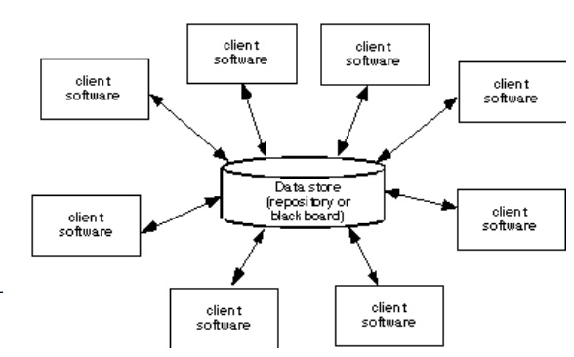
A Brief Taxonomy of Architectural Styles
Styles can be categorized as follows:
Data-Centered Architecture
A data store resides at the center of this architecture and is accessed frequently by other components that update, add, delete, or otherwise modify data within the store.
This architecture promotes integrability. Existing components can be changed and new client components can be added to the architecture without concern about other clients.

Slide 19
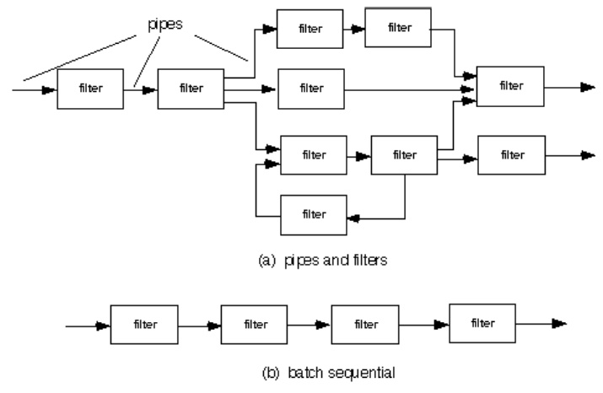
Architecture
This architecture is applied when input data are to be transformed through a series of computational or manipulative components into output data.
A pipe and filter structure has a set of components, called filters, connected by pipes that transmit data from one component to the next.

Slide 20
Thank You

